Slide 1
A Simple Introduction to Scrum Master Certified(SMC)

Slide 2
Scrum Events
1. Sprint.
2. Sprint Planning.
3. Daily Scrum or Daily Standup meeting.
4. Sprint Review Meeting.
5. Sprint Retrospective

Slide 3
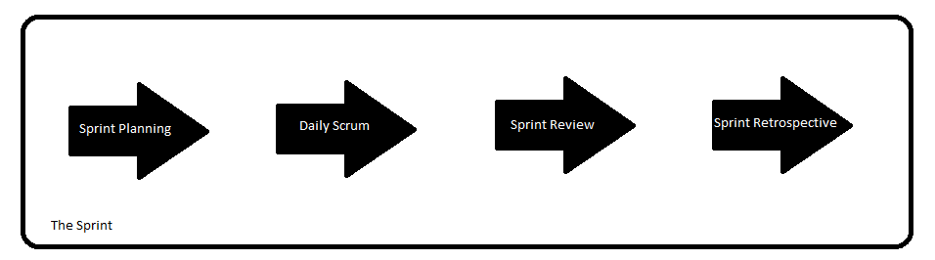
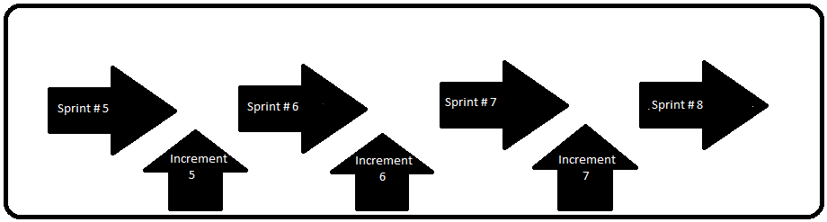
Scrum Events: The Sprint (Part 1)
Each scrum project delivers final product after a number of cycles called Sprints.
An increment is developed in each sprint, which could be potentially be released.
An increment may or may not be released at the end of sprint but is must be potentially releasable.
Customer request changes when they see increment(sprint review) and we apply changes in product backlog.

Slide 4
Scrum Events: The Sprint (Part 2)
Sprint is time-boxed event, its duration should be fixed at beginning of the project.
Items in sprint backlog should not change after sprint gets started.
Sprint goal (discussed in sprint planning) should not change at all.
The PO and Scrum team might try to negotiate scope as more is learned.
Each user story in product backlog should be developed in a single sprint.
Important to agree on definition of “Done” at beginning of project. A 99.99% completed item is not considered “Done”.
It will not be part of increment and demonstrated to customer at sprint meeting.

Slide 5
Scrum Events: The Sprint(Part 3)
Sprint Time Boxes
Most companies uses sprint time boxes of 2 to 4 weeks.
If we use time boxes larger than one month then unapplied changes will become large enough.
Will add complexity and risk.
Sprint should not be too short, else we will not be able to deliver final product.
Can Sprint be cancelled?
The PO has authority to cancel a sprint. This can happen when sprint becomes obsolete, due to changes in product backlog, strategies etc.
When cancelled, items “Done” will be reviewed and accepted and rest will be put back in product backlog.

Slide 6
Scrum Events: Sprint Planning (Part 1)
The Scrum team does not wait until product backlog is 100% complete.
The PO and Scrum team can start the first sprint.
First thing in each sprint is Sprint Planning. [8 hours for 1 month sprint and 4 hours for 2 weeks sprint]
All 3 roles should attend this meeting.
Scrum team estimate work it can do in single sprint.
PO has ranked and ordered product backlog based on value of items.
PO also ensured that user stories are easy to understand.

Slide 7
Scrum Events: Sprint Planning (Part 2)
Scrum team selects the user stories from top of product backlog and puts them in sprint backlog.
Estimation of amount of work is done by Scrum team.
Scrum team should create a sprint goal.
Sample sprint goal:
We are going to enable parts of product to set up login process. This makes other features of product more useful to customer and potential change request will be raised soon.

Slide 8
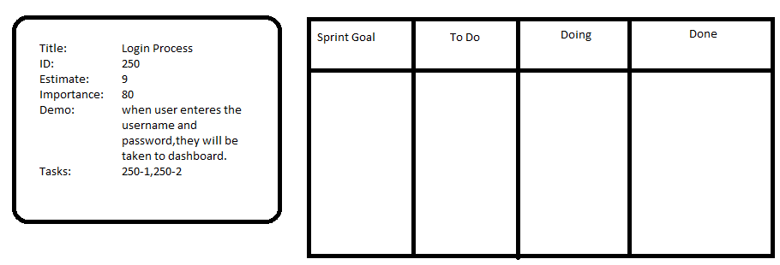
Scrum Events: Sprint Planning (Part 3)
Sprint Backlog will be ready at the end of meeting and scrum team will be able to deliver through sprint.
Following is a sprint backlog and user story shown.

Slide 9
Scrum Events: Daily Scrum(Part 1)
Daily Scrum is a 15-minute time-boxed event for the Scrum Team.
Held every day, Scrum team plans work for the next 24 hours.
The Daily Scrum is held at the same time and place.
Daily Scrum to inspect progress toward the Sprint Goal and to inspect how progress is trending toward completing the work in the Sprint Backlog.
Optimizes the probability that the Scrum Team will meet the Sprint Goal.
It is not a status meeting for all the stakeholders.

Slide 10
Scrum Events: Daily Scrum(Part 2)
During the Daily Scrum, each member of the Scrum Team should answer these three questions:
1. What has been accomplished since the last meeting?
2. What will be done before the next meeting?
3. What obstacles are in the way for me or the Scrum Team from meeting the Sprint Goal?
The Scrum Master ensures that the Scrum Team has the meeting, but the Scrum Team is responsible for conducting the Daily Scrum.
The Scrum Master teaches the Development Team to keep the Daily Scrum within the 15-minute time-box.

Slide 11
Scrum Events: Daily Scrum(Part 3)
The Daily Scrum is an internal meeting for the Scrum Team. If others are present, the Scrum Master ensures that they do not disrupt
Daily Scrums improve:
Communications,
Eliminate other meetings,
Identify impediments for removal,
Highlight and promote quick decision-making, and
Improve the Scrum Team’s level of knowledge.

Slide 12
Scrum Events: Sprint Review (Part 1)
A Sprint Review is held at the end of the Sprint to inspect the Increment and adapt the Product Backlog if needed.
During the Sprint Review, the Scrum Team and stakeholders collaborate about what was done in the Sprint.
Based on that and any changes to the Product Backlog during the Sprint, attendees collaborate on the next things that could be done to optimize value.
This is an informal meeting, not a status meeting, and the presentation of the Increment is intended to elicit feedback and foster collaboration.

Slide 13
Scrum Events: Sprint Review (Part 2)
This is at most a four-hour meeting for one-month Sprints.
For shorter Sprints, the event is usually shorter.
The Scrum Master ensures that the event takes place and that attendees understand its purpose.
The Scrum Master teaches everyone involved to keep it within the timebox.

Slide 14
Scrum Events: Sprint Review (Part 3)
The Sprint Review includes the following elements:
Attendees include the Scrum Team and key stakeholders invited by the Product Owner;
The Product Owner explains what Product Backlog items have been “Done” and what has not been “Done”; The Scrum Team does not present an item, unless it is 100% complete based on the definition of “Done”.
The Scrum Team discusses what went well during the Sprint, what problems it ran into, and how those problems were solved;
The Scrum Team demonstrates the work that it has “Done” and answers questions about the Increment;
The Product Owner discusses the Product Backlog as it stands. He or she projects likely target and delivery dates based on progress to date (if needed);
The entire group collaborates on what to do next, so that the Sprint Review provides valuable input to subsequent Sprint Planning;
Review of how the marketplace or potential use of the product might have changed what is the most valuable thing to do next; and,
Review of the timeline, budget, potential capabilities, and marketplace for the next anticipated releases of functionality or capability of the product.

Slide 15
Scrum Events: Sprint Retrospective(Part 1)
The Sprint Retrospective occurs after the Sprint Review and prior to the next Sprint Planning.
The Sprint Retrospective is an opportunity for the Scrum Team to inspect itself and create a plan for improvements to be enacted during the next Sprint.
This is at most a three-hour meeting for one-month Sprints. For shorter Sprints, the event is usually shorter.
The Scrum Master ensures that the event takes place and that attendants understand its purpose.
The Scrum Master ensures that the meeting is positive and productive.
The Scrum Master teaches all to keep it within the time-box.

Slide 16
Scrum Events: Sprint Retrospective(Part 2)
There is a rule: we should always look for ways to improve. It does not matter how little the improvement is, there should be an improvement.
The purpose of the Sprint Retrospective is to:
Inspect how the last Sprint went with regards to people, relationships, process, and tools;
Identify and order the major items that went well and potential improvements; and,
Create a plan for implementing improvements to the way the Scrum Team does its work.

Slide 17
Scrum Events: Sprint Retrospective(Part 3)
By the end of the Sprint Retrospective, the Scrum Team should have identified improvements that it will implement in the next Sprint.
Implementing these improvements in the next Sprint is the adaptation to the inspection of the Scrum Team itself.
Although improvements may be implemented at any time, the Sprint Retrospective provides a formal opportunity to focus on inspection and adaptation.

Slide 18
Scrum Artifacts
1. Product Backlog.
2. Monitoring Progress Toward Goals
3. Sprint Backlog.
4. Increments.
5. Definition of Done.

